Slide 1

TRANSFER LEARNING FOR IMAGE CLASSIFICATION.
Name – Mukesh Avudaiappan Student Id - 22024161

Slide 2
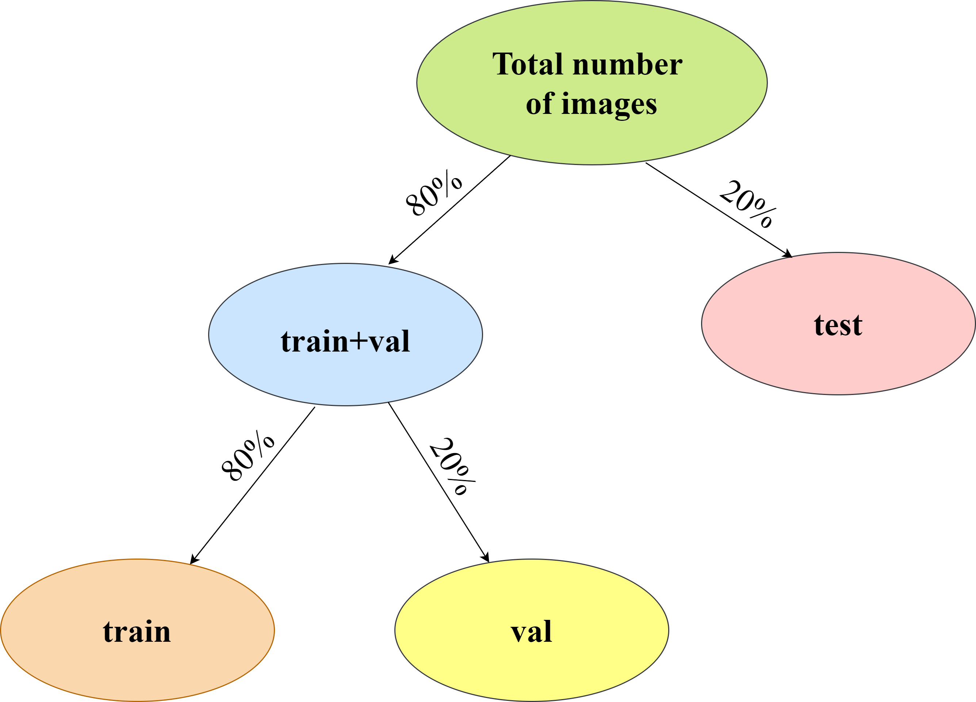
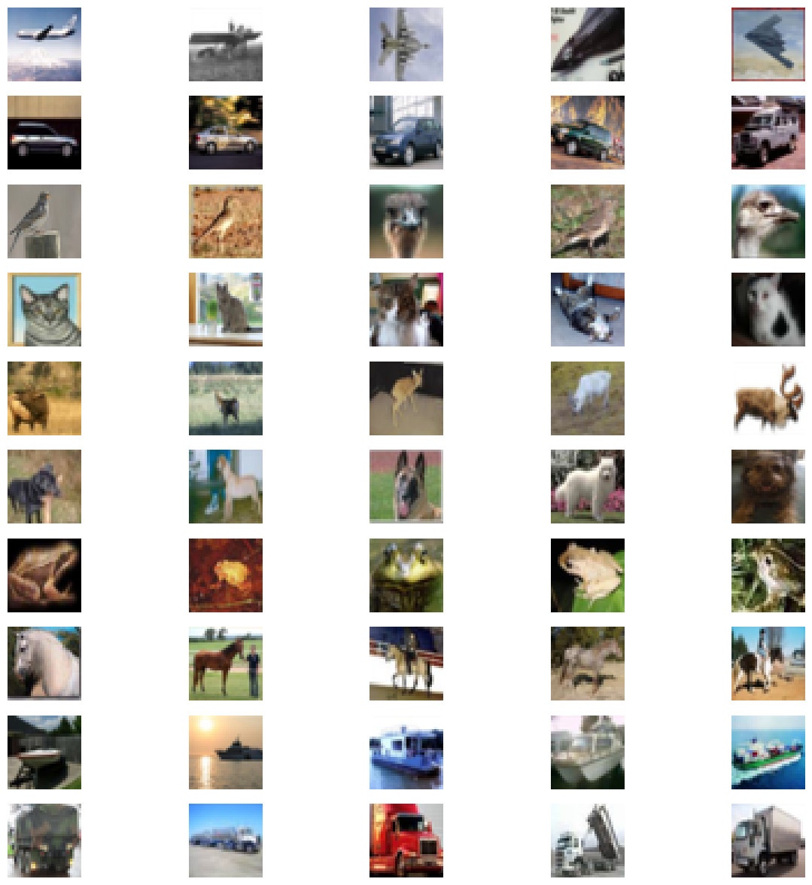
An overview of the CIFAR-10 dataset
CIFAR-10 dataset includes 60,000 color images (32x32 pixels), 50,000 for training and 10,000 for testing. Because of the limited resolution, efficient model architectures and training procedures are prioritized.
CIFAR-10 employs enhanced visual information processing to advance real-world applications such as autonomous driving, surveillance, and image diagnostics.
CIFAR-10 image classification model performance is evaluated using evaluation measures (accuracy, precision, recall, F1 score).

Slide 3
Overview of Transfer Learning
Transfer learning repurposes a model learned on one task to improve performance on a related task, exploiting knowledge obtained from the initial problem.
Transfer learning in deep learning uses neural network models (CNNs, RNNs) that have already been trained, such as those from ImageNet. These models can be made more task-specific by fine-tuning them on smaller datasets.
IT’S IMPORTANCE:
Transfer learning is critical in situations where obtaining labeled data for a specific job is difficult or expensive.
By utilizing the knowledge acquired from previously completed tasks, it expedites the training of models for future tasks.
It enhances generalization by allowing pre-trained models to be applied to areas with little data.

Slide 4
Pre-trained Model Selection and Purpose
ResNet50 is a pre-trained deep learning model that belongs to the ResNet (Residual Network) family and is well-known for its excellent performance in image classification tasks.
ORIGINAL PURPOSE:
ResNet50 took part in the ImageNet Large Scale Visual Recognition Challenge (ILSVRC) and was initially created for picture classification.
Emphasize that there are millions of tagged photos in thousands of categories in the ImageNet collection.
ARCHITECTURE OF ResNet50:
ResNet50 is a 50-layer architecture with a residual building block stack. Multiple convolutional layers, batch normalization, and rectified linear unit (ReLU) activations make up each block.

Slide 5

ResNet50 Fine-Tuning – Layer freeze
LAYER FREEZE FOR ResNet50:
Layer freezing in fine-tuning (e.g., ResNet50) preserves valuable knowledge from the original task, balancing adaptation to a new dataset by selectively preventing updates to certain layers.
Pre-trained weights are preserved by the original choice to freeze all layers, with the exception of be spoke dense layers.
High-level characteristics learned from ImageNet are retained in the model by blocking updates during initial training.
Freezing layers is crucial to leverage knowledge from ImageNet, enabling the model to utilize high-level features and improve pattern recognition.

Slide 6

ResNet50 Fine-Tuning – Unfreeze Strategy
Selective unfreezing of the last 20 layers allows task-specific adaptability for CIFAR-10 without compromising fundamental traits.
This approach allows for task-specific adaptation without compromising lower-level general features.
The ability of the last layers to collect task-specific features justifies their decision to be unfrozen. These layers adjust to the subtleties of the new dataset while keeping lower-level general features.

Slide 7
Comparison of Transfer Learning vs. Training from Scratch
Performance differences are clarified by the comparison, which is important for selecting the right model for a variety of applications.
Accuracy Metrics : The efficiency of each method can be determined by comparing accuracy measures. The side-by-side comparison highlights general accuracy as well as possible differences across several classifications, offering a thorough assessment.
Visual Representation : Visualizing in Transfer Learning accuracy progression with line charts or bar graphs highlights training trends, revealing discernible differences in convergence rates for performance assessment.
Key Insights : Transfer learning is effective, showing faster convergence and potentially higher accuracy by leveraging pre-trained knowledge whereas training from scratch highlights the model's capacity to learn task-specific features independently.

Slide 8
Limitations & Potential Areas of Improvement
LIMITATIONS :
Addressing dataset constraints, such as biases and insufficient diversity, is critical. Acknowledging problems with the quality of the data guarantees a more reliable and objective model.
Identifying intrinsic limits, such as overfitting, dataset size constraints, or sensitivity concerns, provides the framework for a thorough investigation. These limitations direct later initiatives for improvement.
AREAS OF IMPROVEMENT :
algorithmic adjustments, like regularization techniques or innovative architectures, provides actionable strategies to mitigate identified limitations and enhance model performance.
Proposing enhancements in data augmentation strategies is essential for improving model robustness. Diverse training examples address data limitations, leading to better generalization.

Slide 9
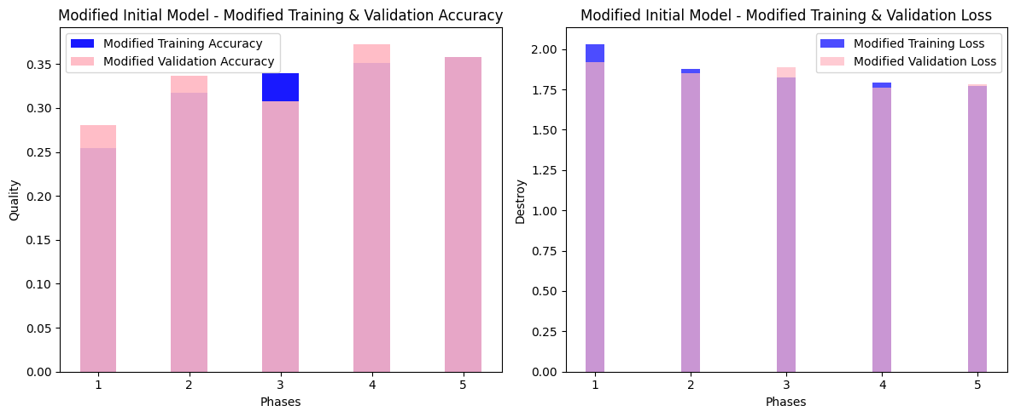
Outcome
The plot_modified_training_history_bar function visualizes training and validation metrics for accuracy and loss in a side-by-side bar chart.
The blue bars represent training metrics, and the pink bars represent validation metrics
The overall obtained ResNet50 accuracy is 35.82%.

Slide 10
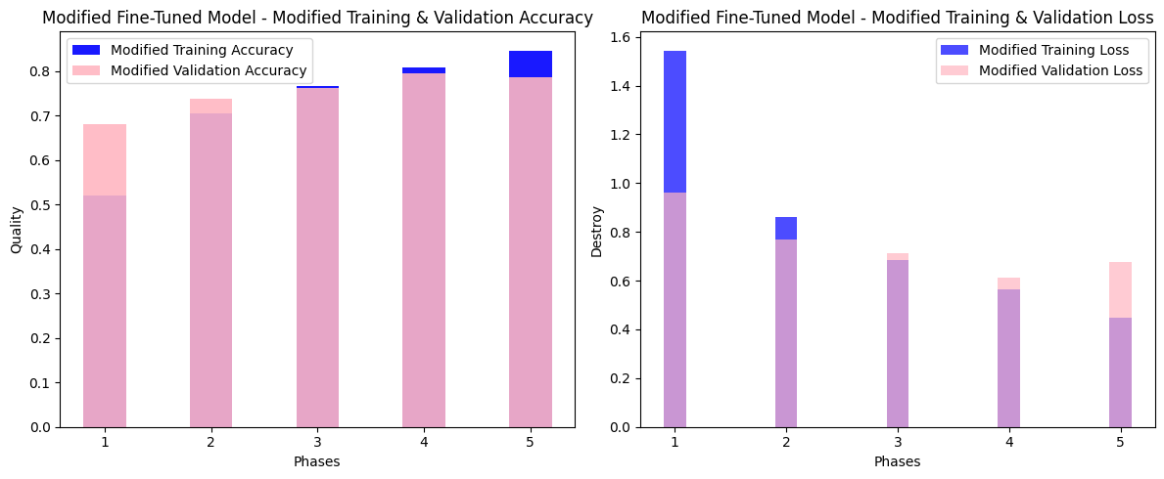
Outcome
Comparing the training and validation history of an initial model and a fine-tuned version.
The visualization aids in assessing and comparing the performance of modified models during training, facilitating effective model analysis.
The ResNet50 model's classification accuracy improved when it was adjusted, and it now has a final accuracy of almost 79%

Slide 11
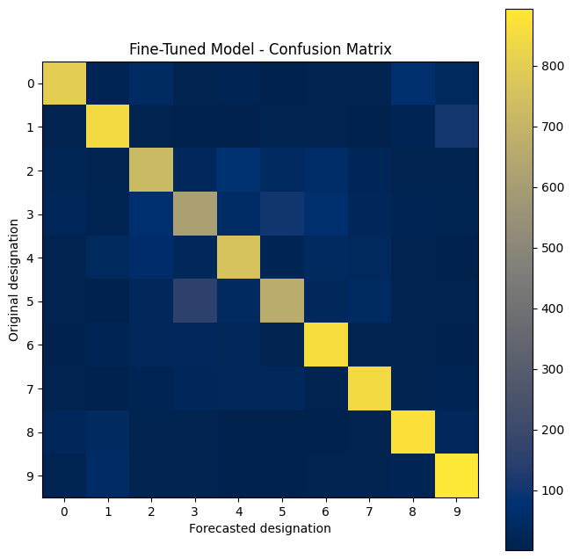

Future Prediction
The function provides a clear visualization of the model's classification performance through a confusion matrix, helps to interpret and analyze the accuracy and misclassifications
Utilizing this function can aid in refining and fine-tuning the model based on observed patterns in the confusion matrix, enhancing its predictive capabilities over time.

